Slide 1
Library Management System
Using Python & Tkinter
Name : Aniket
Roll NO. : 2547240 Summer Traning
2026

Slide 2
Introduction
A Library Management System (LMS) is a software solution designed to automate and streamline library operations.
• Digitizes book cataloguing and member records
Automates lending, returns, and tracking
Eliminates manual paperwork and human errors
Provides quick access to library data and reports
Maintains real-time book availability status
Reduces time spent on record searching and updates
Improves accuracy in tracking borrowed and returned books
Centralizes all library data in a single, secure database

Slide 3
Problem Statement
• Manual record-keeping leads to frequent errors and data loss.
• Difficult to track book lending and timely returns.
• Time-consuming processes for both staff and members.
• No centralized system for managing library resources efficiently.

Slide 4
Objectives
1.
Automate book and member management — streamline adding, updating, and tracking all books and library members efficiently.
2.
Enable easy lending and return process — simplify issuing books to members and recording returns with minimal effort.

Slide 5
Objectives
Provide quick search and filter options for books by title, author, or language.
Generate useful statistics and reports on books, members, and lending activity.

Slide 6
Scope
1.
Manage books, members, and lending transactions with a focus on small to medium libraries.
2.
User-friendly GUI interface with SQLite3 for lightweight, reliable local data storage.

Slide 7
Tools and Technologies
Python — Core programming language used for logic, database operations, and application flow.
Tkinter — GUI toolkit for building the interface. SQLite3 — Lightweight, file-based database for storing books, members, and lending records.

Slide 8

System Architecture
• User Interface (Tkinter): Input forms, navigation, and data display
• Database Layer (SQLite3): Stores books, members, and lending records
• Core Modules: Add Book, Add Member, Lend/Return, Search, Statistics
• Data flows from GUI → Modules → Database and back

Slide 9
Database Design
📚 Books Table
BookID | Title | Author | Pages | Language | Status
👤 Members Table
MemberID | Name | Contact |
🔄 LendRecords Table
LendID | BookID | MemberID | Lend Date | Return Date

Slide 10
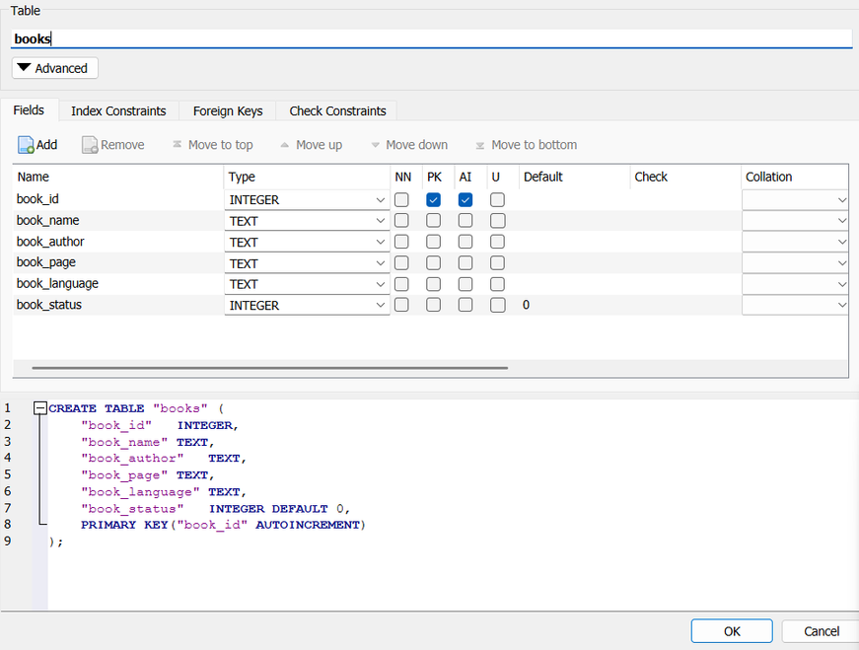
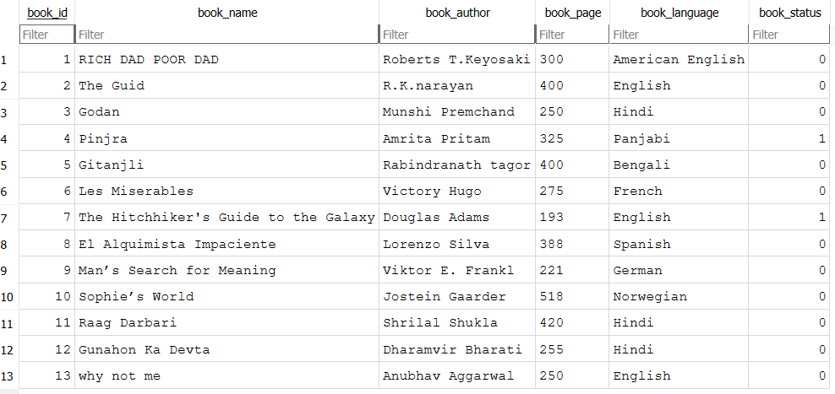

Slide 11
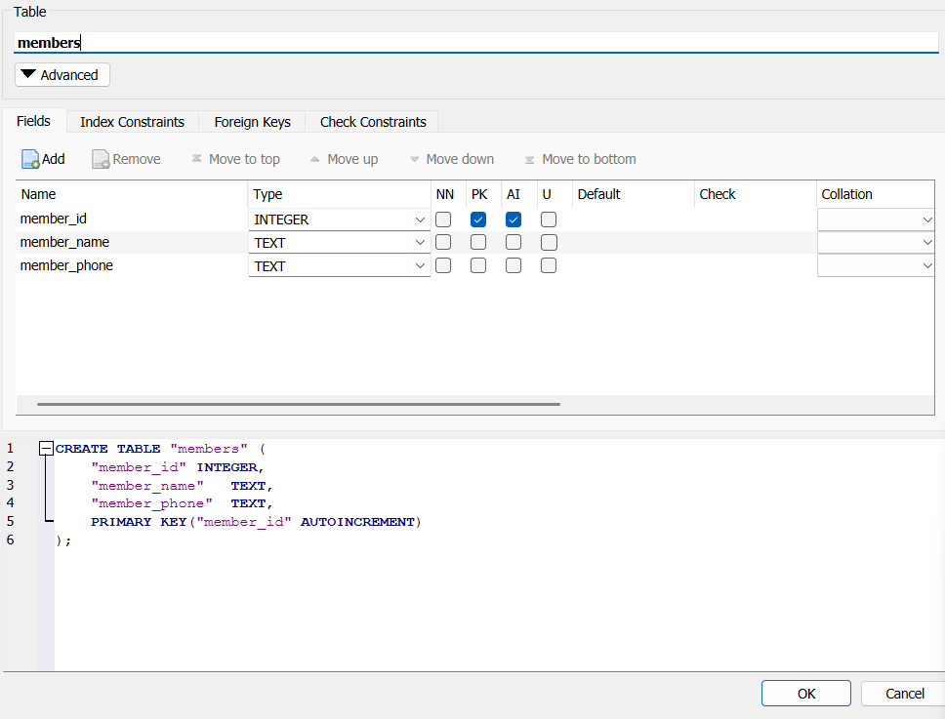
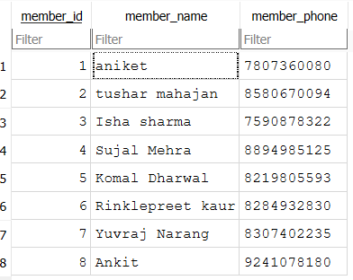

Slide 12
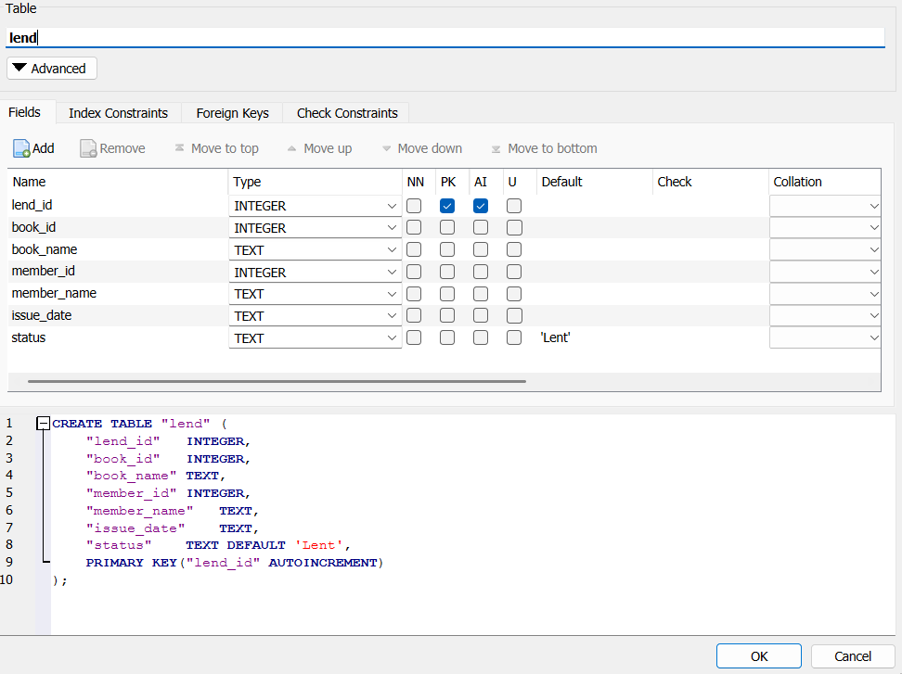
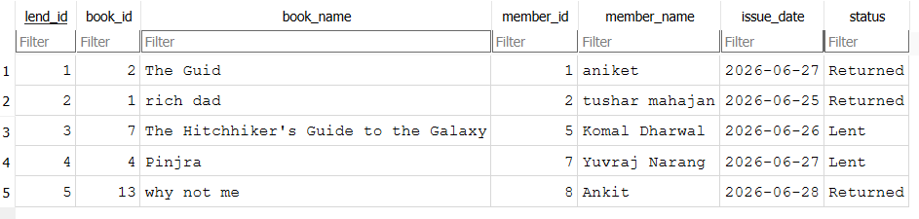

Slide 13

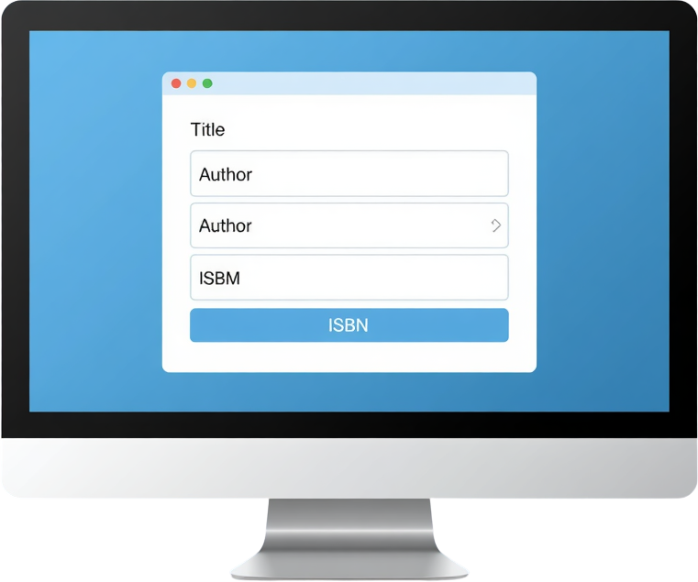


Module 1 - Add Book
• Add new book records to the database
• Fields: Name, Author, Languages, Status
• Validates input before saving
• Instant confirmation on successful entry
• Data stored in SQLite3 Books table

Slide 14
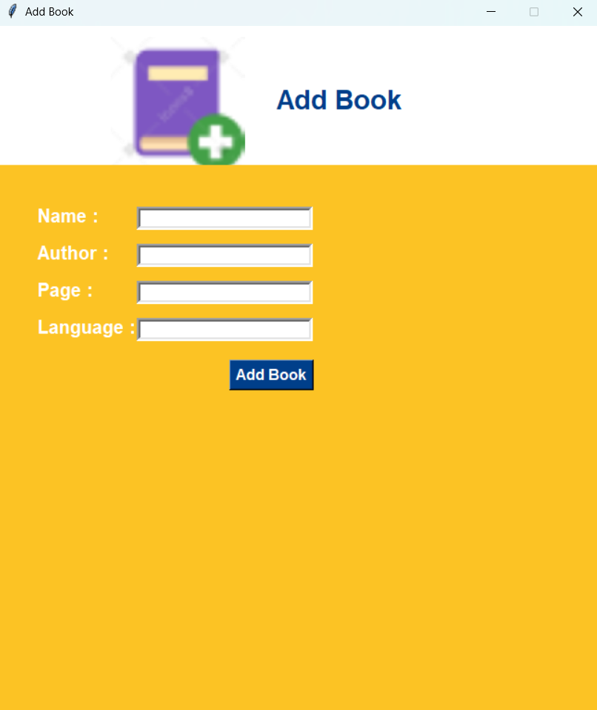

Slide 15
Module 2 - Add Member
Register new library members into the system with ease.
• Member Name: Full name of the library member
• Contact Info: Phone number
• All member records are stored securely in the SQLite3 database for quick retrieval and management.

Slide 16
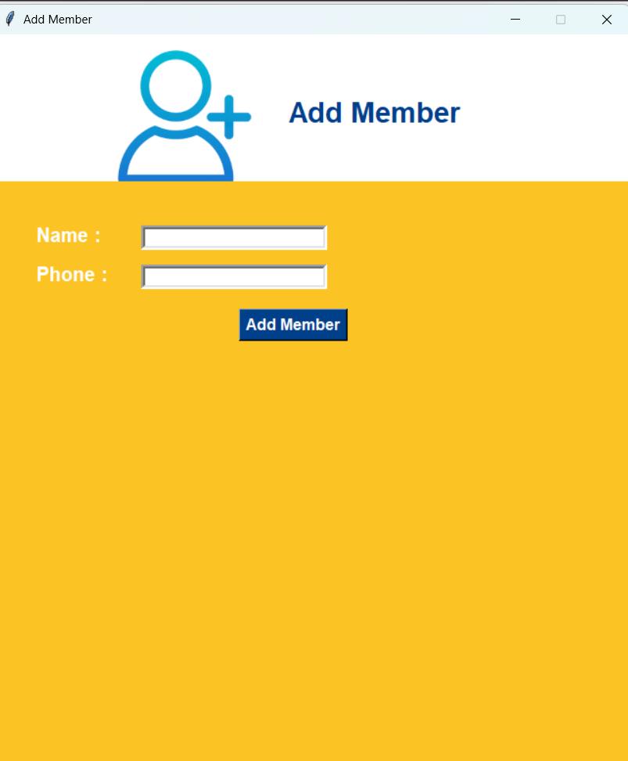

Slide 17
Module 3 - Lend/Return Book
• Manage lending and return transactions
• Fields: Book Name, Member Name, Date
• Track due dates and return status
• Prevents duplicate lending conflicts
• Auto-updates book availability on return

Slide 18
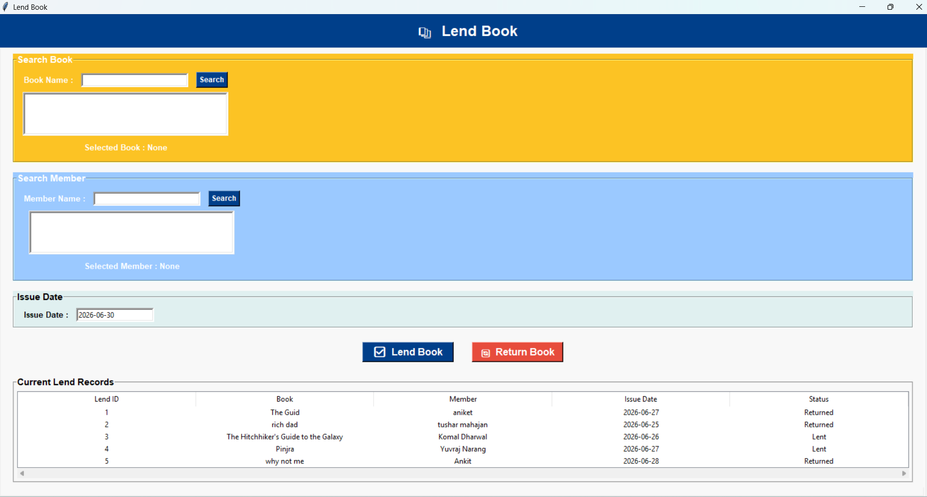

Slide 19




Module 4 - Search & Filter
• Search books by Title, Author, or status
• Filter results by availability status
• Real-time results as you type
• Clean search interface for quick lookups
• Reduces time spent locating books manually

Slide 20
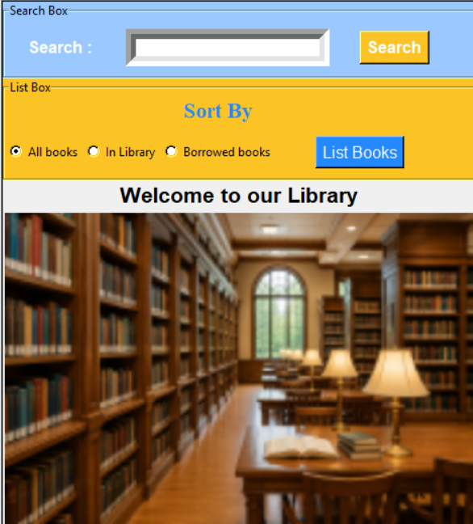

Slide 21

Module 5 - Statistics Dashboard
• Total Books: Displays count of all books in the library
• Total Members: Shows number of registered members
• Currently Lent: Tracks books currently borrowed
• Quick visual summary for instant insights
• Real-time data fetched from SQLite3 database

Slide 22
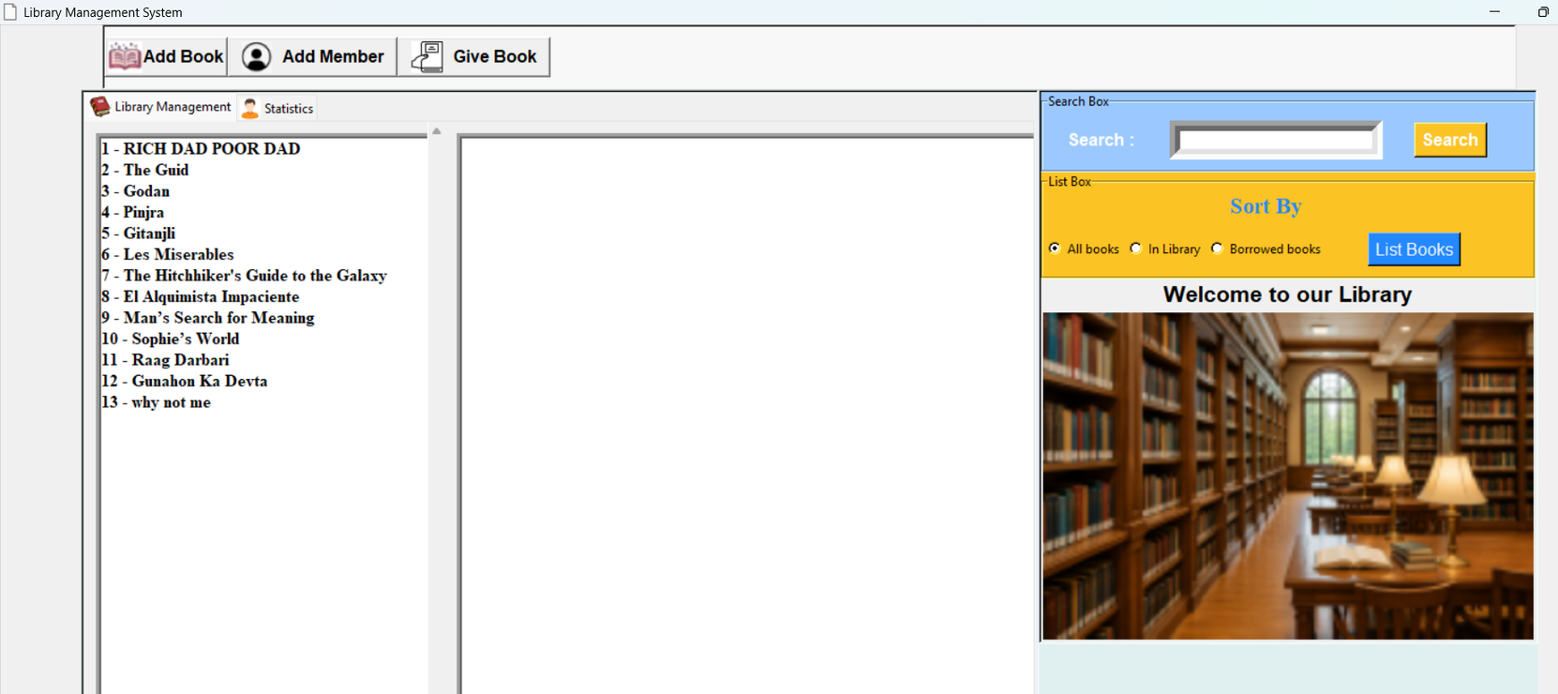
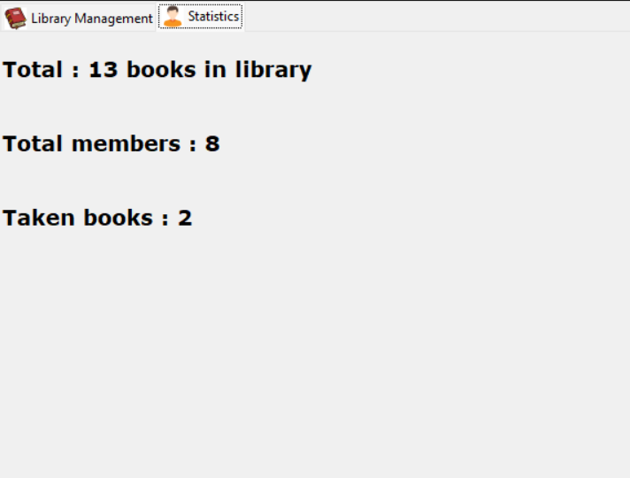

Slide 23
Key Features
User-friendly GUI with Tkinter
Intuitive interface for easy navigation, accessible to all library staff with minimal training required.
Efficient Book & Member Management
Seamlessly add, update, and manage book records and member profiles from a centralized dashboard.

Slide 24
Key Features
Real-time lending and return tracking — monitor all active loans, due dates, and return status instantly.
Search, filter, statistics and reports — quickly find books by title, author, or status, and view library insights.

Slide 25
Advantages
1.
Reduces errors and paper usage. Saves valuable time for library staff and members with faster, automated processes.
2.
Improves record accuracy and accessibility. Enables quick data retrieval and efficient reporting at any time.

Slide 26
Thank You!

